Slide 1
Continuity
(Section 2.6)

Slide 2
Continuity
limit matches function value
Continuity checklist
Is the function value f(a) defined?
Does the limit as x→a exist?
Does the limit match the function value?
A continuous function:
Graph has no holes, breaks, or jumps. You could draw it without lifting your pencil.
When the x-values are close enough to each other, so are the corresponding function values.
When all of the answers are YES, i.e.
,
we say f is continuous at a.

Slide 3
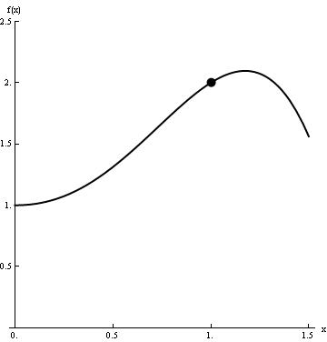
Continuity
limit matches function value
Limit as x→1 exists and matches function value, so function is continuous at x=1.

Slide 4
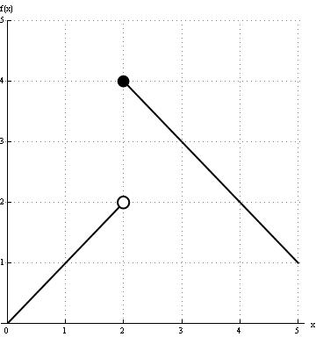
Discontinuity
limit does not match function value
Does Not Exist
Jump discontinuity
(at x=2)

Slide 5
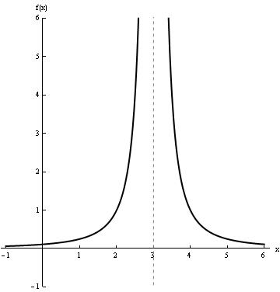
Discontinuity
limit does not match function value
undefined
Infinite discontinuity
(at x=3)

Slide 6
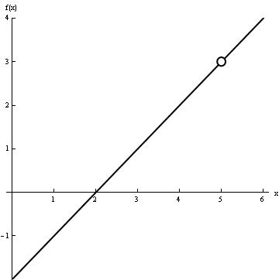
Discontinuity
limit does not match function value
undefined
Removable discontinuity
(at x=5)
The discontinuity can be removed by defining f(5) to be 3.

Slide 7
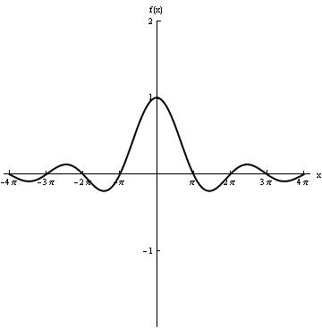
Discontinuity
limit does not match function value
undefined
Removable discontinuity
(at x=0)
The discontinuity can be removed by defining f(0) to be 1.

Slide 8
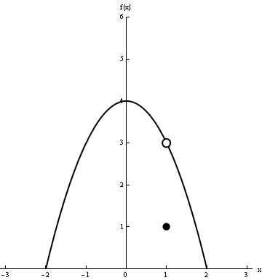
Discontinuity
limit does not match function value
Limit does not match function value
Removable discontinuity (at x=1)
The discontinuity can be removed by redefining f(1) to be 3.

Slide 9
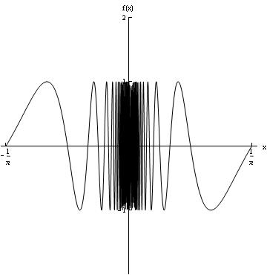
Discontinuity
limit does not match function value
Does Not Exist
Does Not Exist
Does Not Exist
undefined
There is no way to “repair” the discontinuity at x=0.
Oscillating discontinuity
(at x=0)

Slide 10
Continuity
limit matches function value
Continuity checklist
Is the function value f(a) defined?
Does the limit as x→a exist?
Does the limit match the function value?
A continuous function:
Graph has no holes, breaks, or jumps. You could draw it without lifting your pencil.
When the x-values are close enough to each other, so are the corresponding function values.
If all of the answers are YES, i.e.
,
then f is continuous at a.

Slide 11
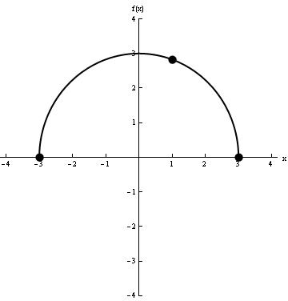
Left and Right Continuity
left-hand or right-hand limit matches function value
Review: Circles
Circle with radius 3,
centered at origin:
continuous
at x = 1
Solve for y:
Top half of circle:
right-continuous at x = -3
left-continuous
at x = 3
Bottom half of circle:

